Slide 1
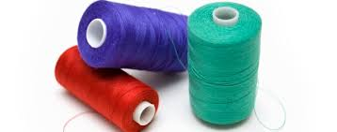
Good Morning

Slide 2
Saakhi Apparels Pvt. Ltd. is a kids ready made garments manufacturing company with a separate unit of Job work. It is a Mumbai based company with a production unit at Bhilai ,CG. Company's main motive is to provide best quality outfits by creating unique designs using soft cotton fabric at the best price for domestic market. Your comfort is the ultimate goal, the entire SAPL team is working 24*7 for.
SAPL is proud to share that it is a 100% women oriented company, founded in 2012, on more than 15000 sq. ft. area, having all lady workers, with a vision to expand the production unit up to 2.5 acres soon.

Slide 3
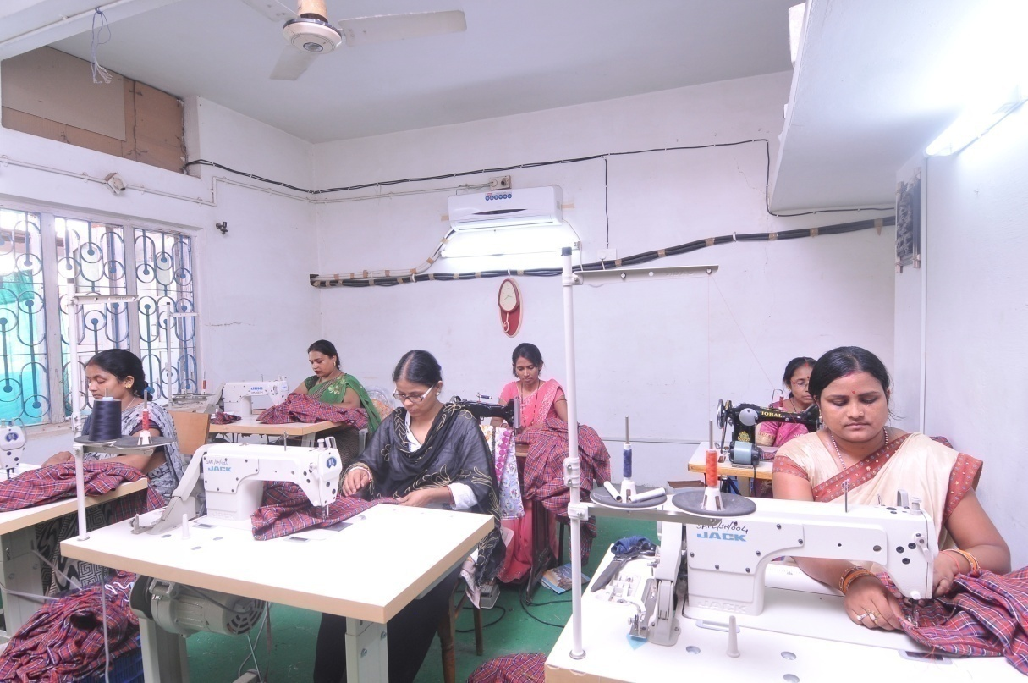
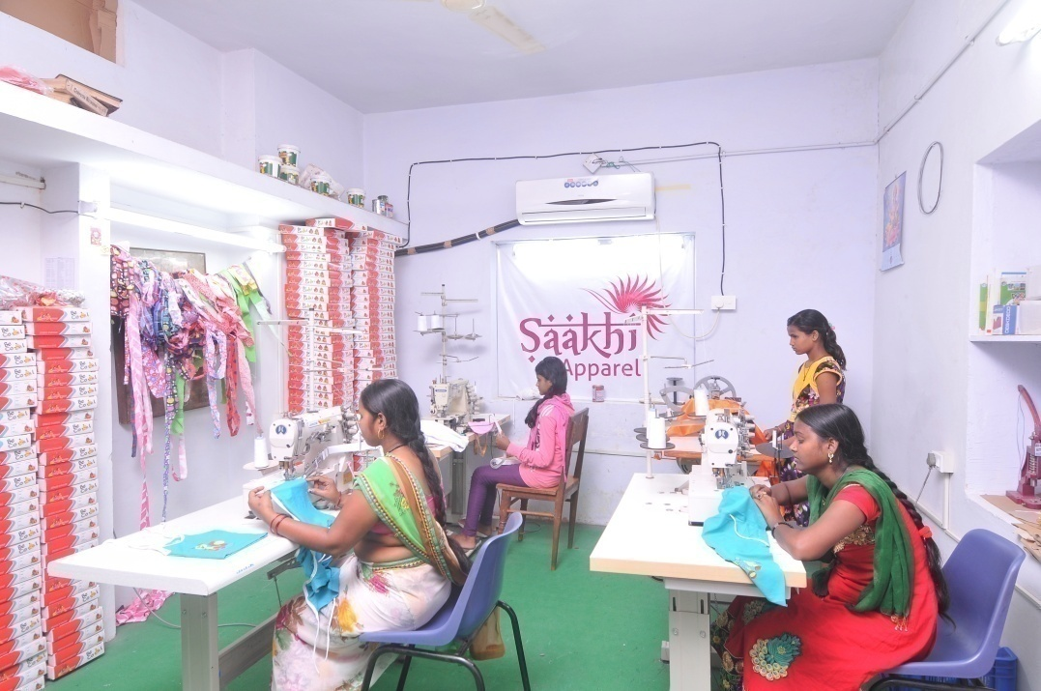
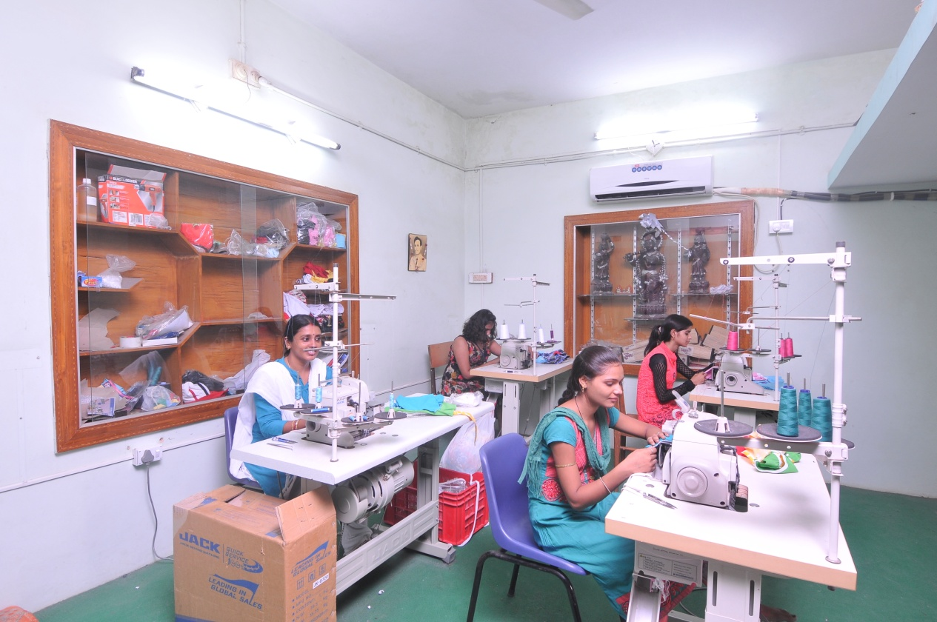

Slide 4
We Deal With Following Sectors For job work:
School/College Uniforms
Staff/Worker’s Uniforms
Hotel/ Hospital Supplies
Vardi [NCC/Police/BSF/CISF]

Slide 5
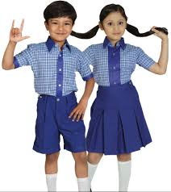
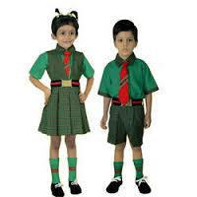
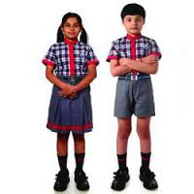
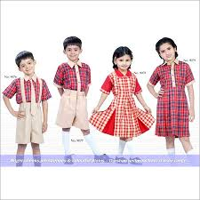
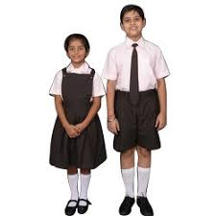
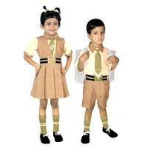
School/College Uniforms

Slide 6
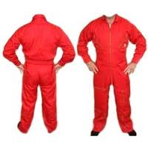
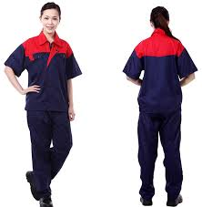
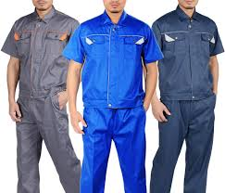
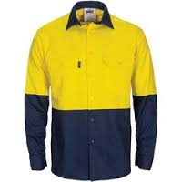
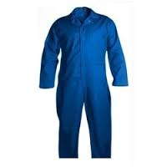
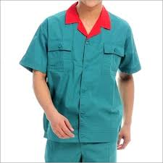
Staff/Worker’s Uniforms

Slide 7
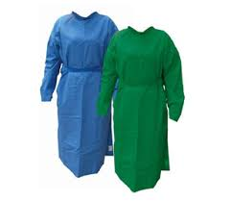
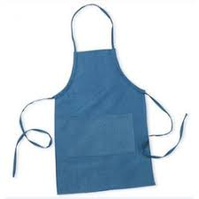
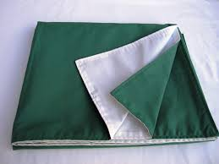
Hotel/ Hospital Supplies

Slide 8
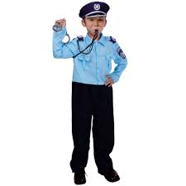
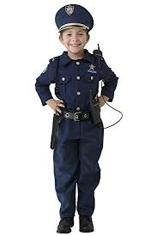
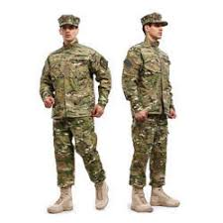
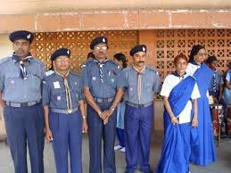
Vardi [NCC/Police/BSF/CISF]

Slide 9
Thanks

